Slide 1

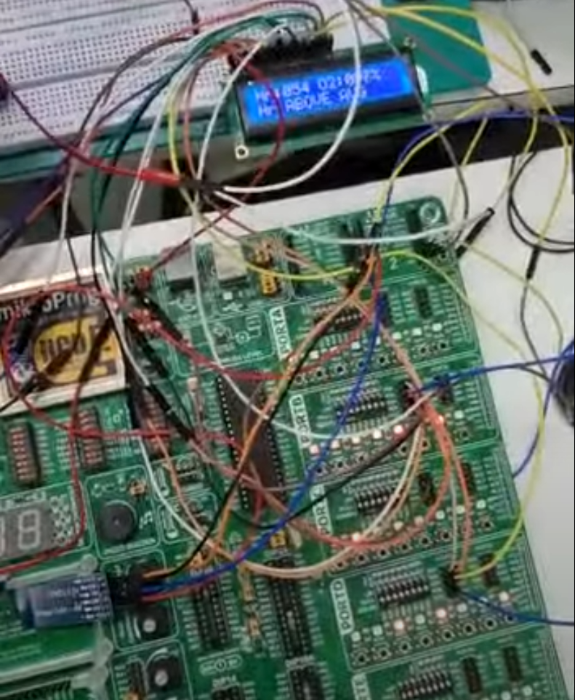
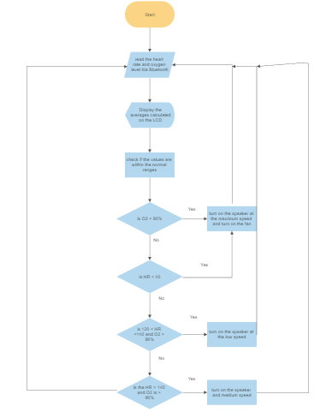
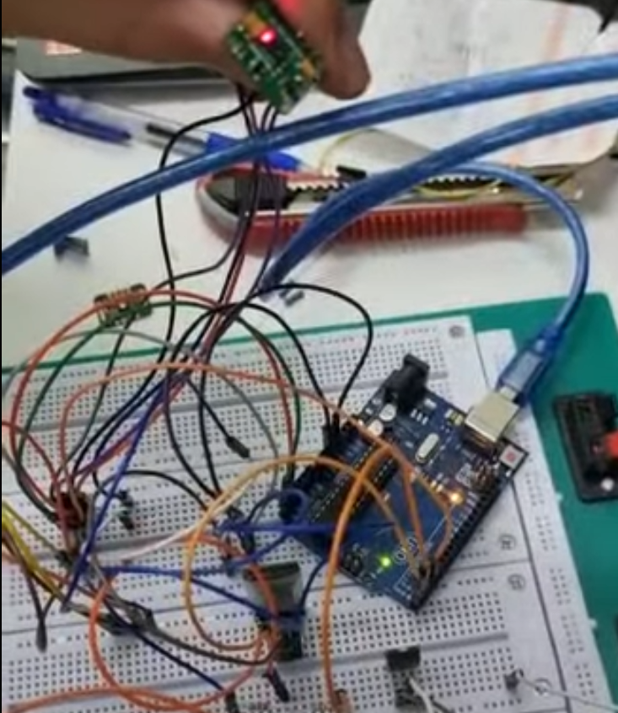
Smart Band
F. Ayyash and H. Abu Haweeleh
Supervisor: Dr. Belal Sababha
Embedded Systems Final Design Project, Fall 2022
King Abdullah II School of Engineering
Princess Sumaya University for Technology
Introduction
This project is made to help with detecting anything that can affect the heart rate and the oxygen saturation in blood of a human being. Such as, gas leakage that the person wont easily be able to detect.
The smart band is composed of oxymeter and a heart rate monitor sensor that can send its data serially to the pic microcontroller, in which it will then calculate the average, display it on an LCD and if needed an alarm system will be activated.
Results
As seen in (Figure2), the pic microcontroller is fully functional and can read , display and respond to events properly.
Figure 2: Blah Blah Blah.
The Smart band can read the heart rate and oxygen level in the blood and send them via Bluetooth using the custom made protocol to make sure that the data is sent and received correctly between both systems, as seen in (Figure 3).
.
Figure 3: Arduino module
Design
The Smart Band contains the MAX-30100 sensor, Arduino Pro Mini, Battery charging unit, Voltage stepper to 5V, LIPO Battery, and RF transceiver.
On the other hand, the PIC is connected to a lithium battery, RF transceiver, a speaker and a fan for the alarm system, and an LCD.
Figure 1: software design
Conclusion
In theory the Smart Band is a safe and effective way to help monitor the heart rate and oxygen level in the blood on a human being. In addition, the implemented alarm system will detect any change in the heart rate or the oxygen levels in the blood and it will help the person wearing the band avoid possible danger on their life.

